Slide 1
System Operator Industry Forum
11 November 2025
Notes:
Tēnā koutou, tēnā koutou, nau mai, hoki mai
Hi and welcome to the SO Industry Forum
I’m […], one of the SO senior leadership team here at TP
Housekeeping:
Can you keep your camera and mic off for most of the presentation unless you are speaking
AI note takers – we’ve noted a few people using them on these sessions and often that results in everyone being spammed by the tool. . We won’t be letting AI notetaker tools into these meetings. And a reminder we do record these sessions, and the recording and slides go up on our webpage immediately after the session.
Questions
You are welcome to add any questions you have to the chat,. We welcome questions and will get to the questions at the end.
There are different levels of market or system understanding so please ask if you need more clarification –our experts are happy to explain points.
In some cases we may not be able to answer Qs directly, but we will take these away and either contact you directly or respond in the next briefing. We had one of those last week and we will respond to a couple of those Qs at the end.
Before we get into today’s agenda, we would like to acknowledge that, we experienced Loss of Supply to the Hawkes Bay region at around 3 am this morning with all load and generation restored by 5am. Low residual notice was issued and we came through the morning peak with just a little 230MW residual – we would like to thank all those who have responded to both the event and the Low residual notice. For those who are interested, we will cover this event in more detail at the next forum.

Slide 2

Today’s agenda
Key messages
Market update
2026 SOSA
NZGB update
Outage update – next 4 weeks
Outage planning notifications​
Operational update
Consultations, publications and events
Questions / Patai
Notes:
As Usual the Standing Agenda for the day is -

Slide 3

Key Messages
Nationally, hydro storage is above the historic mean for this time of year due to increased inflows.
Spring has seen demand soften due to warmer weather, more planned outages and less firm thermal generation offered.
Spring weather events are challenging the power system.
Participants are asked to be responsive when needed and keep offers up-to-date especially during this busy outage period.

Slide 4
Market update
Notes:
Now for our Market Update
Pass it over to Oliver – Market Analyst

Slide 5
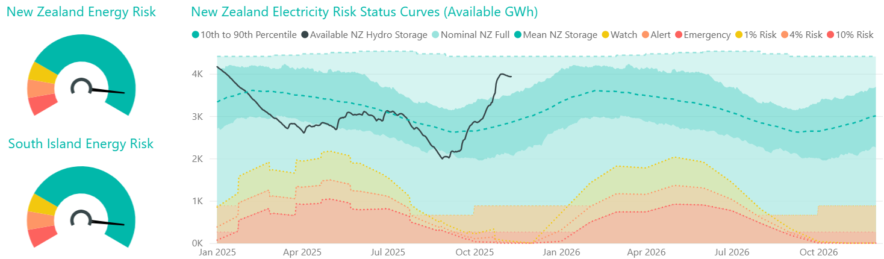
Energy: National hydro storage
 | Hydro storage level (% of mean▲/▼)
 | New Zealand | South Island | North Island
Last forum | 143% | 142% | 134%
Now | 137% ▼ | 138% ▼ | 131% ▼
Note: these numbers include contingent storage, so they differ from those reported by NZX

Slide 6
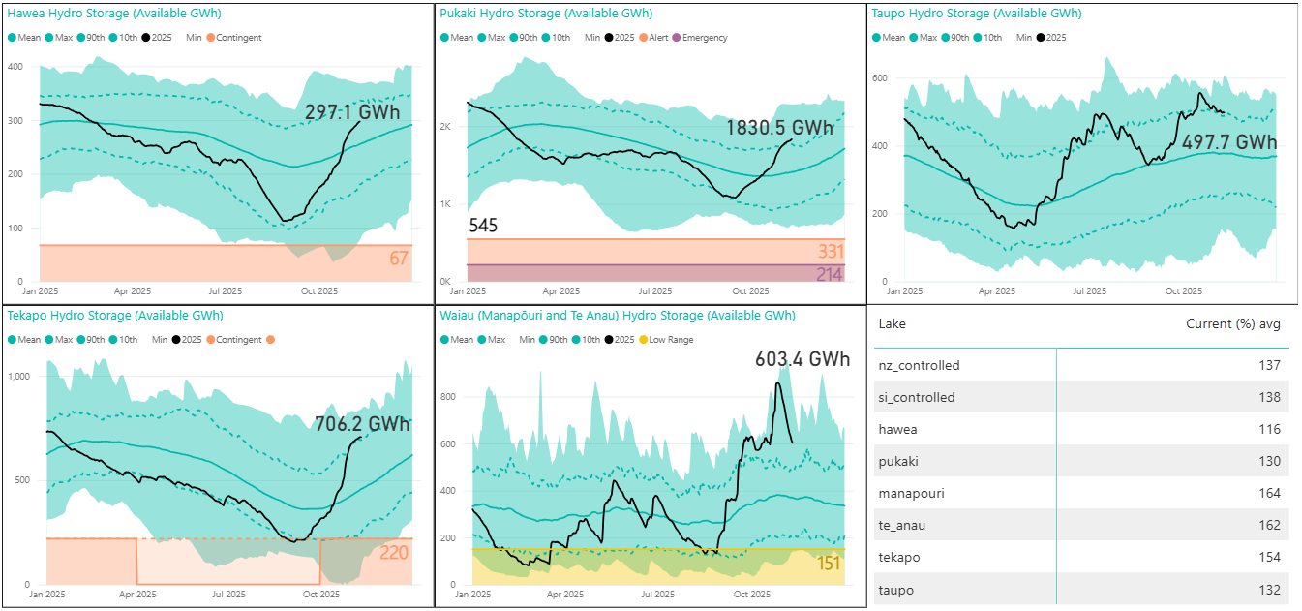
Hydro storage by catchment

Slide 7
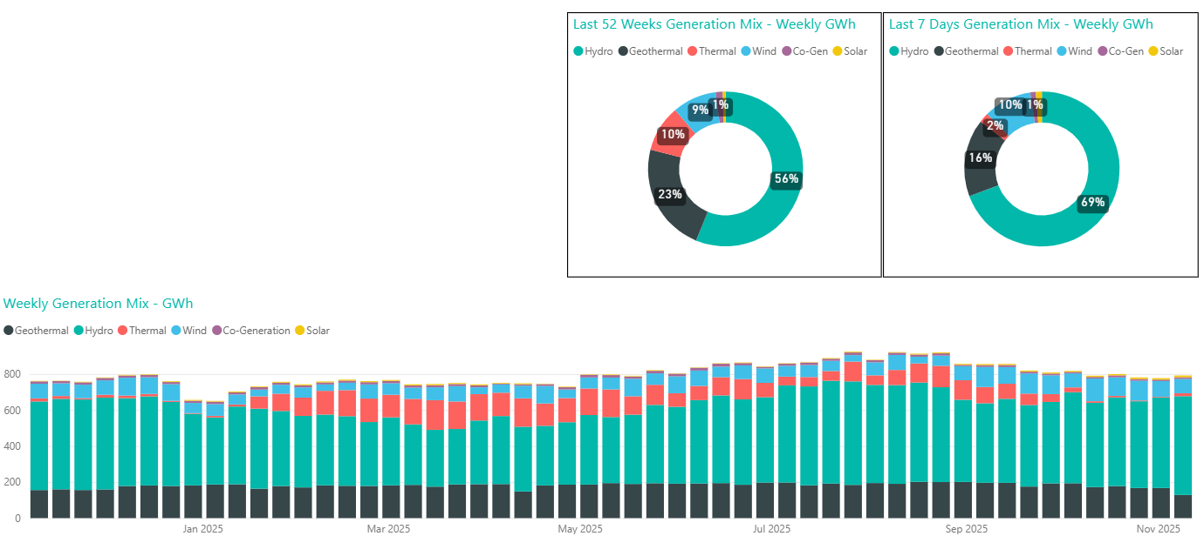
Generation mix
  Hydro generation share above average at 69%.
  Wind generation close to average at 10%
  Thermal increased from 0.5% to 2%
  Geothermal below average at 16% due to multiple planned outages

Slide 8
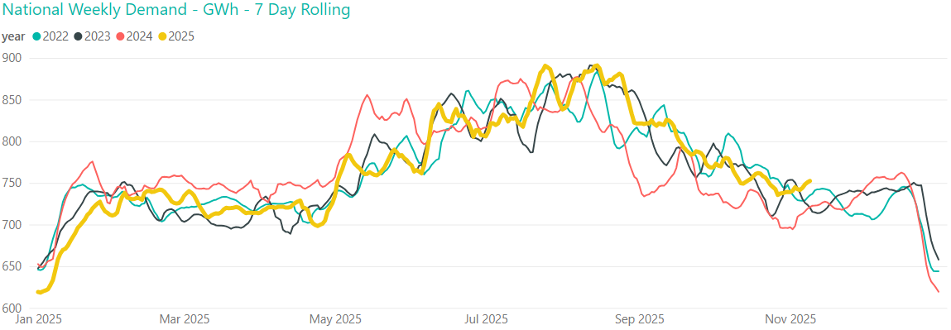
Demand
Slight increase in demand over the last two weeks with colder temperatures
752 GWh last week, and 741 GWh the week before

Slide 9
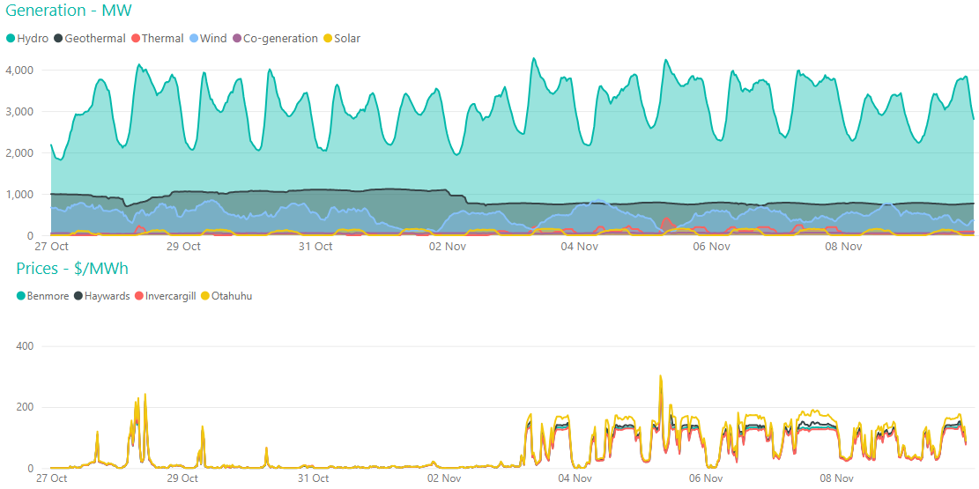
Pricing
Average Ōtāhuhu price was $107/MWh last week, and $12/MWh the week prior
Higher prices in line with periods of lower wind and an increase in thermal generation
Peak of $303/MWh at Ōtāhuhu, 7:30am on Wednesday 5 November during a period of low wind
Notes:
Wholesale prices peaked during highest demand and lowest residual period of the week
With higher hydro storage price volatility has increased, typically up around $200 over periods of peak demand or low wind, and dropping off the rest of the time

Slide 10
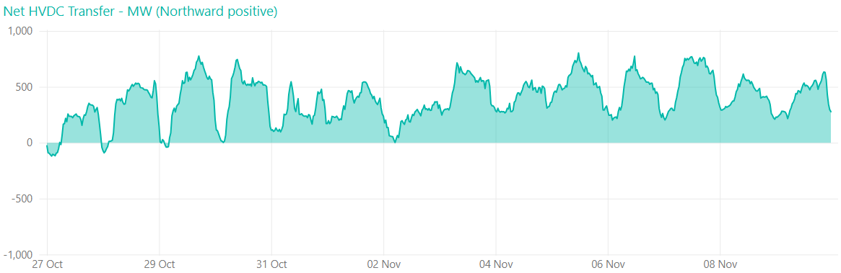
HVDC transfer
  Last week 80 GWh sent north, 0 GWh sent south

Slide 11
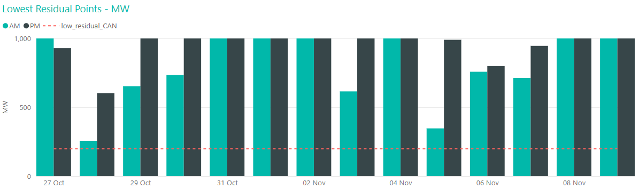
Capacity residual margins
  Mostly healthy residual margins despite slight increase in demand
  Lowest residual 256 MW during 28 October morning peak
Notes:
As we move further into spring we continue monitoring capacity closely despite a decrease in peak demand meaning most of the time the residual is healthy. During the shoulder seasons with an increase in outages, reduced thermal unit commitment, and continued possibility of cold snaps or large swings in output from wind generation, capacity can still be tight despite much lower demand.

Slide 12
2026 Security of Supply Assessment
Notes:
Now for an overview of the 2026 SOSA reference case and sensitivities consultation.
Pass it over to Oliver – Market Analyst

Slide 13
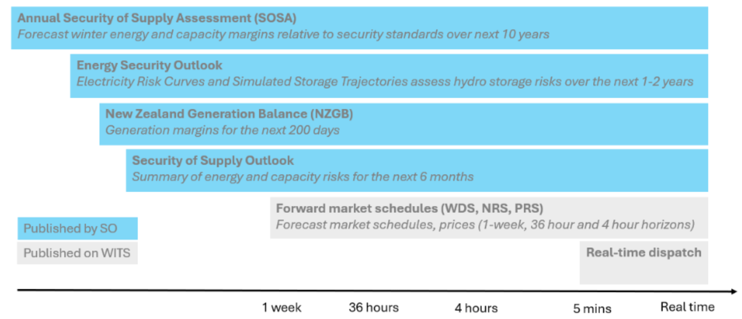
2026 Security of Supply Assessment

Slide 14
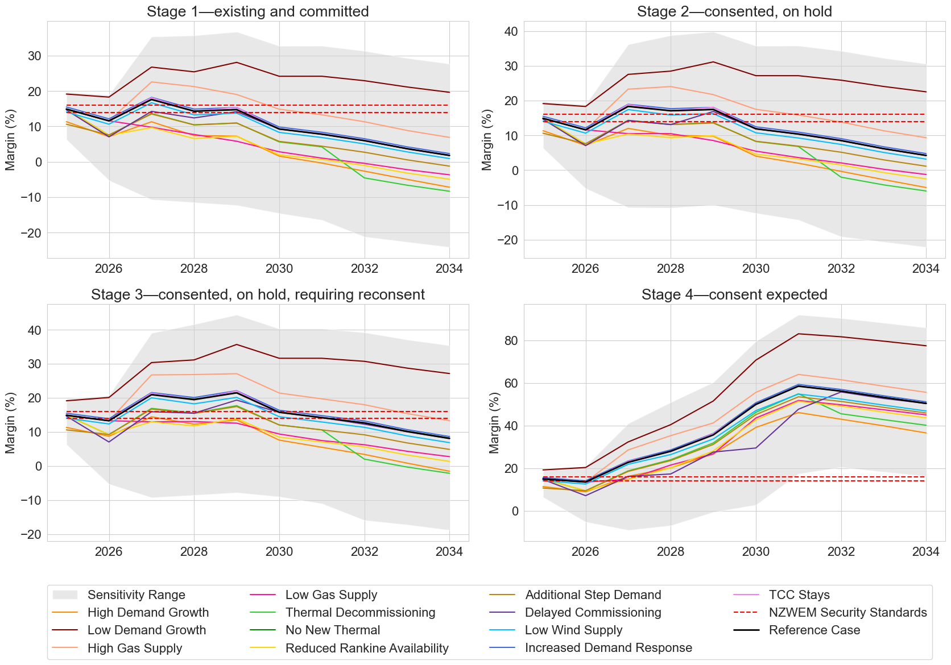
2026 Security of Supply Assessment
New Zealand Winter Energy Margin – SOSA 2025

Slide 15
2026 Security of Supply Assessment
Reference case
The purpose of the reference case is to provide a consistent baseline against which changes in the power system can be compared. It reflects, where reasonable, a continuation of current conditions.
Proposed changes from this year’s SOSA are:
Modify pipeline stages: Exclude projects that have consent, but are unlikely to proceed
  Stage 1: Committed (with Final Investment decision)
  Stage 2: Consented and likely to proceed
  Stage 3: Consent likely to be sought within 2 years
Gas supply and demand: Assume exit of Maui, Methanex, and Ballance Kapuni in 2027

Slide 16
2026 Security of Supply Assessment
Sensitivities
Proposed changes from this year’s SOSA are:
TCC: Remove the “TCC stays” sensitivity
Additional step demand: Remove this sensitivity
Change in thermal mix: This will replace “thermal decommissioning”
Delayed build times: We have asked for pessimistic commissioning dates in our survey to inform this sensitivity, instead of a blanket 1-year delay
Low wind and solar supply: This will replace “low wind supply”
Expected Future case
This will be the combination of sensitivities that we consider reflects the most likely outcome. This may differ from the Reference case.

Slide 17
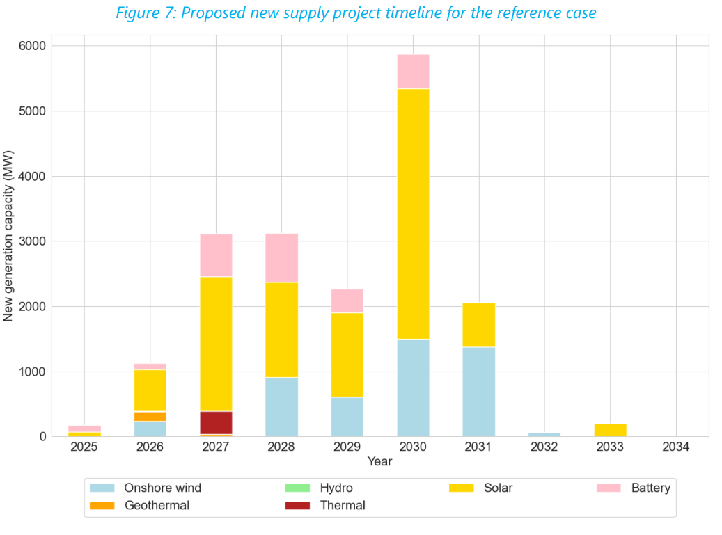
2026 Security of Supply Assessment
SOSA pipeline
Thank you to all 2025 survey respondents
SOSA 2025

Slide 18
2026 Security of Supply Assessment
Survey
We survey participants as an input to our SOSA supply pipeline.
EDBs, and generators who have an account with the Grid Owner’s customer team, have been surveyed.
Industry participants, as defined in section 7 of the Electricity Industry Act 2010 (Act), who have been surveyed are required to respond by section 9.18(1)(f) of the Code. This is a new requirement.
Information will be treated confidentially. The Electricity Authority (EA) now requires the System Operator to provide this survey information to the EA under section 46(2) of the Act, for the purpose of carrying out the EA’s monitoring functions. Information will not otherwise be shared unless explicitly allowed by the respondent.
If your organisation is planning to build any significant new generation or energy storage and you aren’t sure if you received the survey, please contact market.operations@transpower.co.nz

Slide 19

2026 Security of Supply Assessment – Questions?

Slide 20
NZGB update
Notes:
Next items, NZGB update followed by outages update
Theo, handing it over to you

Slide 21
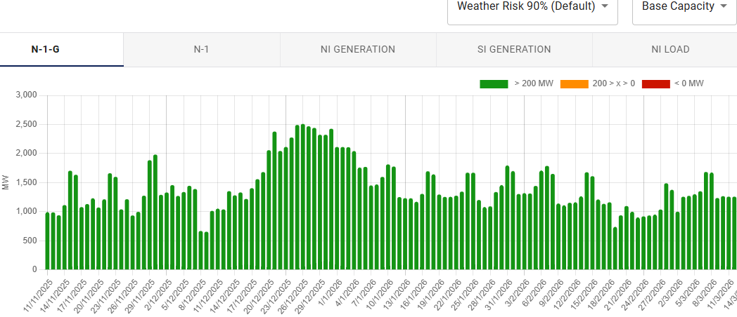
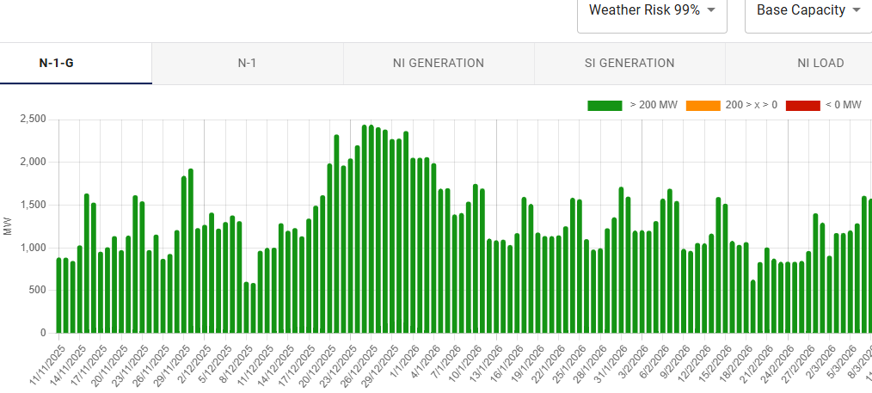
NZGB update: base capacity N-1-G
N-1-G margins are currently showing healthy values
Under the 99th percentile load, which we would expect under a cold snap, the margins drop but are still healthy
Base case capacity at 90%
This triggers the CAN process
Assumes all generation available in POCP is offered
It uses 20% of total wind capacity
90th percentile load
99th percentile load

Slide 22
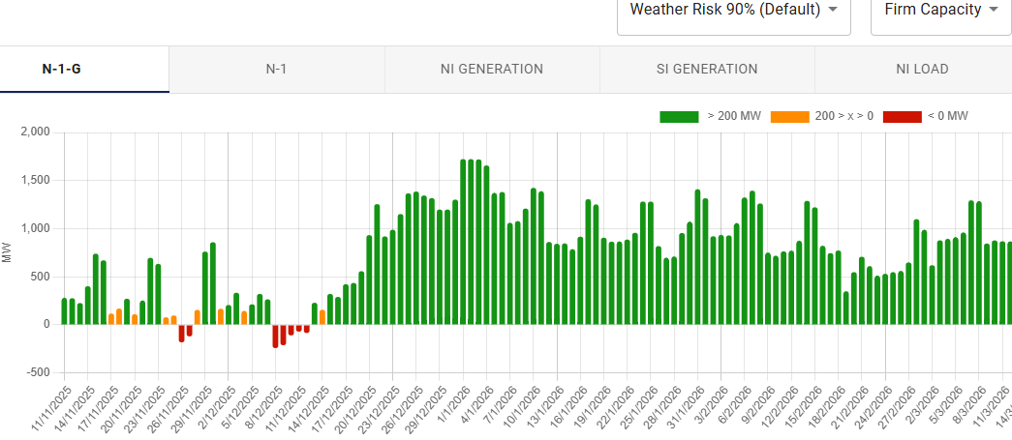
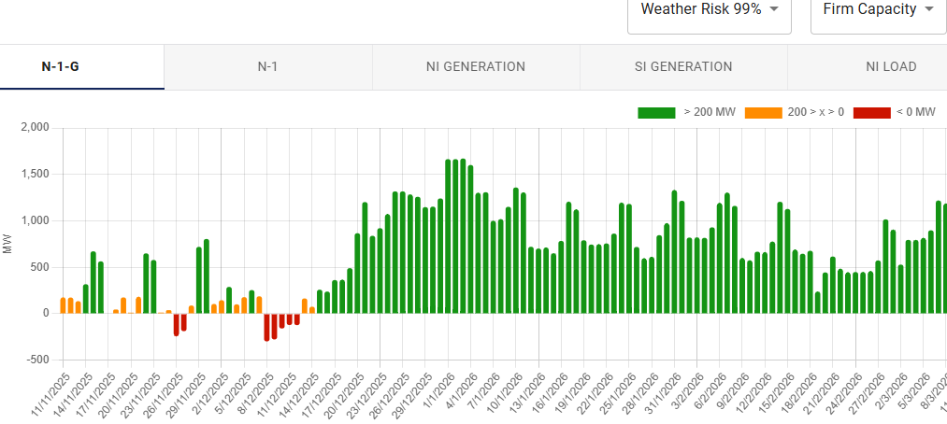
NZGB update: firm capacity only N-1-G
Firm capacity scenario reflects units that historically operate for at least 90% of AM & PM peaks.
Any shortfall or low margin periods highlight the potential reliance on these units to be available to cover N-1-G
This means we are relying on the market to coordinate especially slow starting thermal units, to get through high peak load periods
Firm capacity removes
TCC (-360MW) all months
HLY 5 (-405MW)
2 HLY Rankines from 1st Oct to 31 Dec 2025, and 2 Rankines over the remaining months
It uses the lowest 10th percentile generation for wind (8% of total capacity)
THI-WKM-1 outage
WKM-WRK-1 outage
90th percentile load
99th percentile load

Slide 23
NZGB update: Information
Recommendations from SO:
Avoid further outages during periods with low margins
Market coordination is required from industry to ensure available generation capacity remains high to cover potential cold snaps
Keep POCP updated with scheduled or tentative outages
Keep the WDS up to date with the latest offers
Any other information on plant availability, please contact the SO

Slide 24
Outages next 4 weeks
Notes:
Theo

Slide 25
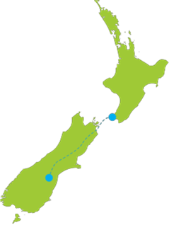
Outages
NNI outages
SNI outages
SI outages
NNI
SNI
HVDC
SI
Asset owners
Check in POCP for detailed dates
Consider the impact on your own outages
Notes:
2081 individual equipment outages across NZ between Sept and Dec 25
All in POCP
This is some of the major ones.
For Asset owners you can check in POCP for outage dates and consider the impact on your own outages.

Slide 26
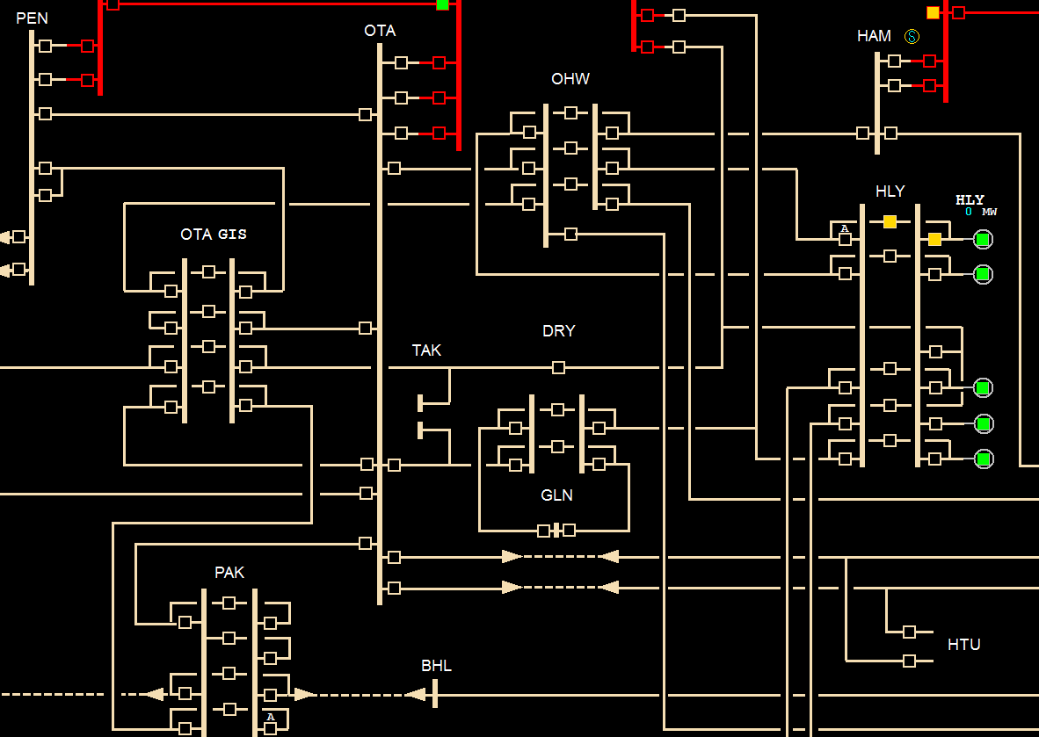
NNI Outages
Week of 17 Nov
  OTA_PEN_5
  OHW_OTA_2
  OTA_HTU_WKM_1
Week of 24 Nov
  OTA_HTU_WKM_1
  DRY_TAK_OTA_2
  KAW_OHK_1
Week of 1 Dec
  HEN_SWN_1
  OTA_HTU_WKM_2
  DRY_TAK_OTA_1
  EDG_TRK_1
Week of 8 Dec
  HLY_OHW_2
  EDG_TRK_2
Notes:
17 Nov​
Potential voltage management into Auckland​
24 Nov​
Potential voltage management into Auckland​
Reduced security in BoP ​
1 Dec​
Potential voltage management into Auckland​
8 Dec​
Potential voltage management into Auckland

Slide 27
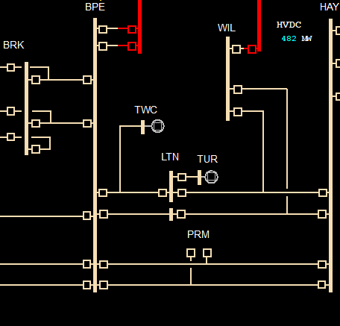
SNI Outages
Week of 17 Nov
  BPE_PRM_HAY_2
  BPE_TNG_1
Week of 24 Nov
  HLY_SFD_1
  THI_WKM_1
  BPE_PRM_HAY_2
  BPE_TNG_1
Week of 1 Dec
  HLY_SFD_1
  HAY_WIL_LTN_1
  THI_WRK_1
Week of 8 Dec
  HAY_WIL_LTN_2
  WKM_WRK_1
Notes:
17 Nov​
HVDC limit reduced​
24 Nov​
Second WRK ring outage – constrained back WRK ring generation​
HVDC limit reduced​
1 Dec​
Third WRK ring outage​
HVDC limit reduced​
8 Dec​
Fourth WRK ring outage​
HVDC limit reduced​

Slide 28
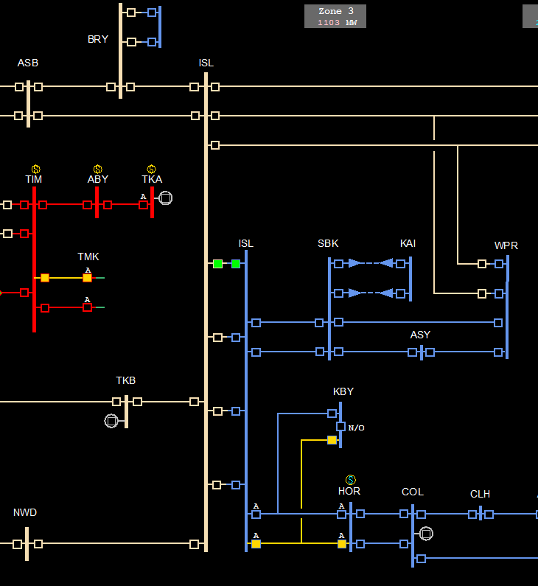
SI Outages
Week of 17 Nov
  ISL_WPR_CUL_KIK_3
  MAN_NMA_1
Week of 24 Nov
  CUL_KIK_2
  MAN_NMA_2
Week of 1 Dec
  ASB_BRY_1
  KIK_STK_2
  ISL_WPR_CUL_KIK_3
  MAN_NMA_1
  INV_ROX_2
Week of 8 Dec
  KIK_STK_1
  HWB_SDN_1
  MAN_NMA_3
  INV_ MAN_2
Notes:
Week 3 we have a ASB_BRY outage that have an impact on voltage stability in the upper South Island. This can be managed by generation and controllable load.​
All 4 weeks have multiple concurrent outages in the lower south island that could constrain on generation in the area.​
17 Nov​
None​
24 Nov​
CUL_KIK_2 jumpers cut away from ISL_WPR_CUL_KIK_2 for tower replacement.​
1 Dec​
Potential Zone 3 and GZ14 VSAT​
8 Dec​
Potential Zone 3 and GZ14 VSAT​

Slide 29
HVDC North transfer limit
Notes:
Having SC3 & SC4 out reduces the HVDC limit by 100MW in north transfer and 50MW in south transfer.
SC9 out reduces the HVDC limit by a further 100MW in north transfer and 50MW in south transfer
HVDC equipment outages and Lower NI AC line outages affect the HVDC limit.
Why do we care if the HVDC hits it’s limits? Residual and reserves are impacted. In a dry scenario with south transfer more SI generation will be required and in the market there is price separation between the islands.

Slide 30
Outage planning notifications
Notes:
Angela

Slide 31

Outage planning notifications
We are changing the way you receive and view outage notifications as we transition to our new outage planning tool.
From Tuesday 31st March 2026, we will be using the Grid Operations Customer Portal to view and respond to outage notifications.
You will continue to receive email alerts when a notification has been created that impacts you.
In January, we will email our Connected Parties directly with instructions on how to set-up access.
If you’re not yet registered as an interested participant and would like to be, contact outageplanners@transpower.co.nz and we will make sure you’re ready to in March 2026.

Slide 32
Operational update
Notes:
Now we have Chris – who will cover the Operational Update

Slide 33
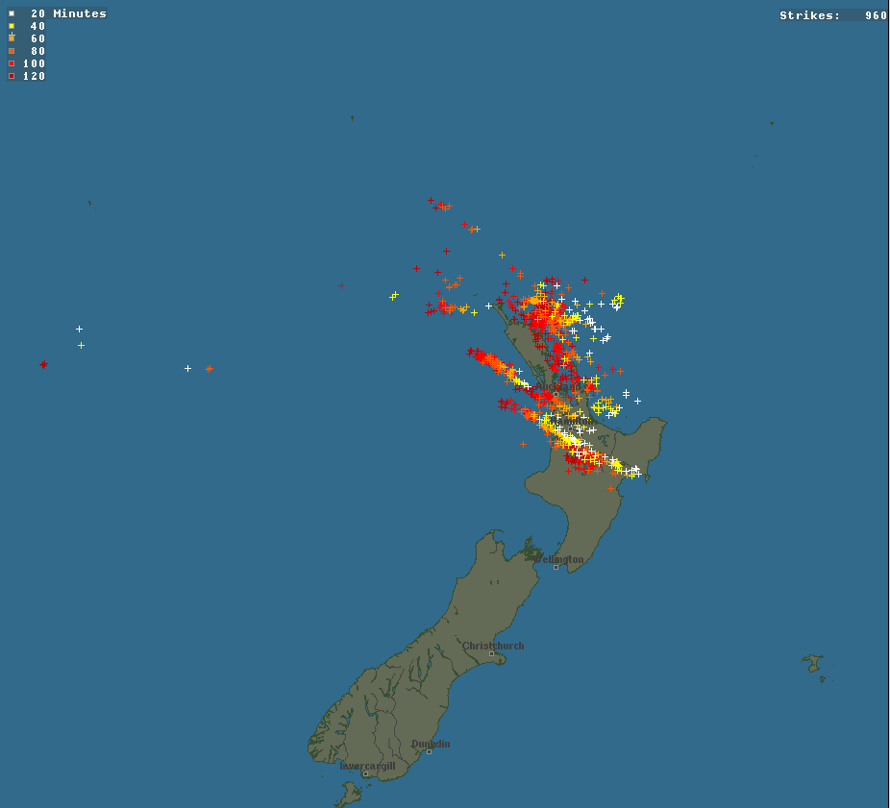
28 October 2025 Hawke’s Bay LOS
02:33: Double circuit tripping of the two 220kV circuits between Hawke’s Bay and Wairakei (Taupo).
Loss of 120 MW load (including Napier, Hastings & Gisborne)
Loss of 135 MW generation.
02:51: Grid Emergency declared and restoration initiated.
04:40: Restoration completed

Slide 34
28 October 2025 Morning Peak Low Residual
Low residual was identified for the morning peak in the 06:30 NRSS schedule.
  <200 MW NI residual at 08:00.
A CAN was issued to notify the industry.
Cause: Relatively small reductions across multiple generators.
  These added up to a ~400 MW drop in NI generation for the morning peak (when comparing 02:00 and 06:30 schedules).
Actual residual over the peak exceeded 200 MW.
  Wind generation was slightly higher than forecast.

Slide 35
Consultations, publications, and events
Notes:
Next on the agenda is a Reminder for Consultations, publications and event.

Slide 36

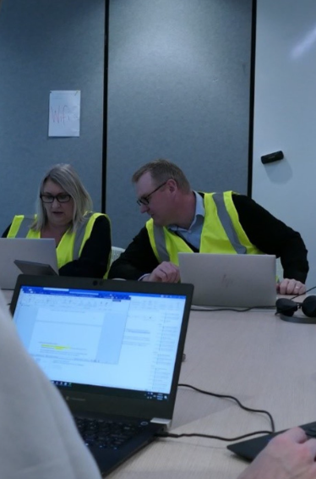
Consultations, publications, and events
We received 6 submissions to our draft SOSFIP amendment proposal consultation. Thanks to those who submitted. The period for cross-submissions closes at 5pm today!
The 2026 SOSA reference case assumptions and sensitivities consultation is open. Submissions are due by 5pm Monday 24 November.
Last week we published our CACTIS summary of submissions and recommendations to the recent CACTIS consultation.
Our 2025 Ancillary Services tender closed last Wednesday, we are now processing the tender responses as we work to contract the successful providers by early December.
The October Energy Security Outlook is available on our website.
The GridEx industry exercise is taking place on 17/18 November, any queries contact GridEx@transpower.co.nz
Notes:
SOSFIP – Security of Supply Forecasting and Information Policy

Slide 37
Questions / Patai
Please raise your hand
If you have feedback let us know via our Feedback Form
Notes:
Now moving into questions and answers – feel free to use the chat and/or raise your hand to participate
Thank you for joining us today, we look forward to you joining us in 2 weeks time – until then feel free contact us should you have any questions on the information presented here today, or feedback on the session.
Ka Kite.

Slide 38
Fortnightly Operations Update
Other
Number Unplanned Outages (EXN) | 12
Number Under Frequency Events | 0
Number Grid Emergencies (GEN) | 0
Low Residual / Shortfall Situations | 1
6/7 August – Hawkes Bay Restoration Workshop
13 August – Brief Transpower ICCP outage
19 August – Insufficient transmission capacity Hawkes Bay (20/8)
Short Summary of Unplanned Outages
5 August - Edgecumbe Kawerau 1 Auto-reclosed 7 August - Edgecumbe Owhata 2 Auto-reclosed 7 August - Ohakuri Wairakei 1 Auto-reclosed 11 August - Bream Bay T2 Tripped 12 August - Tiwai Reduction Line Tripped 13 August - Matahina Generation Tripped 14 August - Ashburton Timaru Twizel 2 Auto-reclosed 16 August - Penrose STC 1A Tripped, Penrose STC 1B Tripped 17 August - Wanganui Waverley Auto-reclosed 18 August - Islington Southbrook 1 Auto-reclosed 18 August - Tiwai Reduction Line Tripped 18 August - Huirangi T6 Tripped 19 August - WRN Insufficient transmission capacity Hawkes Bay (20/8)
Looking Ahead
NCC Team Training in Progress (Round 2)
GSO Team Forum (Oct)
For the fortnight August 5th – 17th 2025

Slide 39
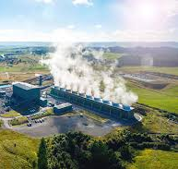
Operations Update: Inflexible Generation Outcomes
We’ve spoken previously about priorities when dispatching generation down within a constrained area or during low demand situations.
SPD looks for the most economic solution. It doesn’t account for the physical limitations of generating plant and their ability to consistently vary or generate at very low levels.
When generation is offered at the same price, infeasible dispatch solutions can arise, at which point NCC can use discretion to produce a viable outcome.
A general priority is intermittent generation off first, then hydro and thermal down to minimum run (if required on for security reasons), and lastly, geothermal.
Notes:
Tim

Slide 40
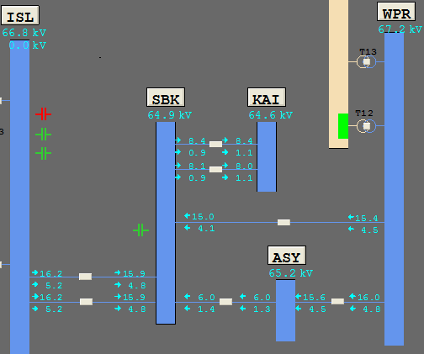
North Canterbury 66kV Circuit Overload Protection Scheme (COPS)
The scheme involves four sub schemes, one on each of the following circuits:
• Islington–Southbrook 1
• Islington–Southbrook 2
• Ashley–Waipara 1
• Southbrook–Waipara 1
 | N-1-1 (One Planned outage and a tripping)
Without SPS | Load management from ASY, SBK, KAI ≤ 77MW to 80MW
With SPS | More flow to ASY, SBK, KAI up to 133MW (70% more flow into the region)
This COPS will disconnect any overloaded circuit if there is a tripping on the remaining network during a planned outage on the 66kV network

Slide 41
SO Generation Commissioning & Testing update
Notes:
Anna

Slide 42
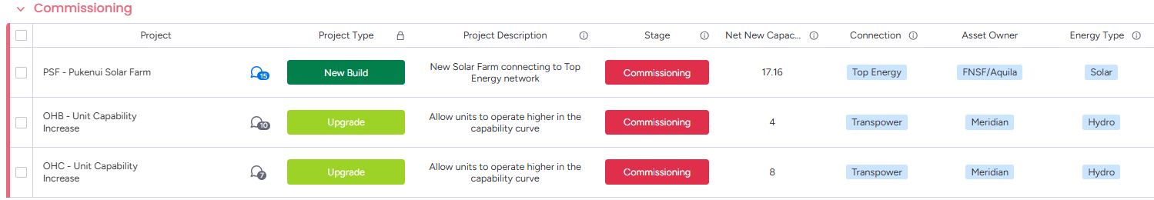
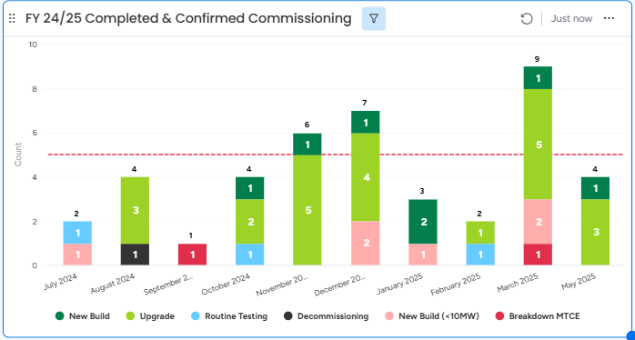
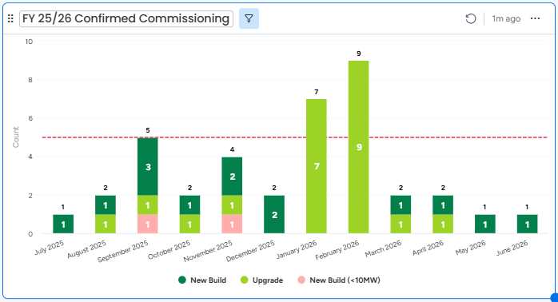
In-flight commissioning, routine testing & upgrade projects
Total Projects: 42
Total New MW: 299
Total Projects: 38
Total New MW: 932
Notes:
Here is the latest snapshot of our in-flight commissioning, routine testing & upgrade projects
Currently in the Commissioning space
PSF has commenced their commissioning testing in May
OHB and C is going through commissioning and testing to operate at the uplifted MW outputs later in June
Recently Completed Commissioning's
Ruakākā completed commissioning at the end of last month
Upcoming Commissioning's (Chart on the right)
10 new builds due to complete commissioning between now and the end of the year - which will bring on over 400MW of new generation capacity
The sooner Routine testing and commissioning
Since our last update, we have one upgrade project entering into the commissioning & testing pipeline with a planned synchronisation date in December.

Slide 43
Information published regarding meeting peak demand
Annual Security of Supply Assessment (SOSA)
Forecast winter energy and capacity margins relative to security standards
New Zealand Generation Balance (NZGB)
Generation margins for the next 200 days
Winter Outlook / Quarterly Security of Supply Outlook
Shape and size of energy and capacity risks for period
Forward market schedules (WDS, NRS, PRS)
Forecast market schedules, prices
Residual capacity
Real-time dispatch (RTD)
Sensitivity schedules
Wind generation forecast
Controllable load visibility
10 years
200 days
6 months
1 week
36 hours
4 hours
1 hour
5 mins
Real time
Notes:
Matt
Let’s first take a quick look at the information available to you.
Our Annual Security of Supply Assessment (SOSA) provides information on winter and capacity margins over the next 10 years.
NZGB provides a view of the next 200days, Theo will cover that in more detail shortly
Then there is the Quarterly Security of Supply outlook – which provides view of the next 6 months of energy and capacity risks
Before we get into the market schedules, and information available via WITS and EM6

Slide 44
Roster
Internal only
Date | Chair | Markets | Planning | Operational | Next chair | Comms | Impartiality / compliance | Tech Sec | Sponsor
1 Apr | Matt
15 April | David
29 April | Katherine
13 May | Rebecca
27 May | David
10 June | Matt
24 June | Katherine
8 July | Rebecca
22 July | David
5 August | Matt
19 August | Katherine
2 Sept | Rebecca
16 Sept | Matt |  | 11 November | Matt
30 Sept | David |  | 25 November | David
14 Oct | Rebecca |  | 9 December | Rebecca
28 Oct | Katherine

Slide 45
Process overview
Internal only
Activity | When | Who (lead in bold) | What
Prep | Tues 9.30am | Chair Presenters (Markets, Outages, Operations) Note does not need all 3 every week – could include PS as well) Assurance (Richard) Comms (Nathan) Tech Sec (Carol) | Confirming and checking material and roles (material should be pre-loaded) Reviewing answers to prev Q&A
2. Industry Forum | Tues 11am | Chair 3x Presenters (Markets, Outages, Operations) Note does not need all 3 every week – could include PS as well) Assurance (Richard) Comms (Nathan) Tech Sec (Carol) | Deliver forum!
3. Debrief | Tues 11.40am | Chair Presenters (Markets, Outages, Operations) Next chair Assurance (Richard) Comms (Nathan) Tech Sec (Carol) | Review feedback (internal and from audience) Assign owners to offline Q&A Identify opportunities to improve / change in future
4. Offline checks | Using Teams channel during alternate week | Tech Sec (Carol) Chair | Confirm attendees against roster Confirm horizon of diary invitations
 |  | Tech Sec (Carol) Comms (Nathan), Assurance (Richard), next Chair | Check progress of offline Q&A responses

Slide 46
1. Prep meeting – 9.30am Tuesday
Internal only
Chair to run this meeting and ensure checklist is covered
Checklist
Item | Confirmed by | Y / N
Every slide has a presenter (unless decided there is no update for an item) | Chair
Every slide has material (if there is no update for an item then say this on a placeholder slide) | Chair
Material is appropriate: SO independence | Assurance (Richard)
Material is appropriate: audience lens (relevance, tone, level of detail) | Comms (Nathan)
Material is appropriate: duration of presentation items < allocated timeslots | Chair
Q&A from last time: all questions have an answer or placeholder | Chair
Q&A from last time: assurance on all answers (SO independence, compliance risk) | Assurance (Richard)
Backup presenter and offline version of slides prepared | Tech Sec
Pre-check that all presenters have the right invitation | Chair

Slide 47
2. Industry Forum – 11am Tuesday
Internal only
Standing agenda
Item | Who | When | Duration
Welcome, housekeeping | Chair | 11.00am | 1
Introduction | Chair | 11.01am | 1
Markets update | Presenter 1 | 11.02am | 5
Outages update (System operator issues which have an impact on multiple industry participants) | Presenter 2 | 11.07am | 5
Operational update (System operator issues which have an impact on multiple industry participants) | Presenter 3 | 11.12am | 5
Projects & events New or upcoming project news Events (recent, upcoming) Other engagement (consultations, surveys) | Chair | 11.17am | 2
Q&A | Chair | 11.19am | 10
Close | Chair | 11.29am | 1

Slide 48
3. Debrief meeting – 11.40am Tuesday
Internal only
Chair to run this meeting and ensure checklist is covered
Checklist
Item | Confirmed by | Y / N
Feedback: All audience feedback is captured | Katherine | Y
Feedback: Reflections and feedback from internal team is captured |  | Y
Feedback: Any actions or decisions that have come from feedback have owners and deadlines |  | Y
Slides: Today’s presentation is saved in the archive | Carol
Slides: Blank presentation created for next time | Carol
Q&A: All unanswered questions added to next presentation | None
Q&A: All unanswered questions have owners assigned | N/A
Next Chair accepts handover

Slide 49
4. Offline checks (done between forums)
Internal only
Tech Sec owns and manages this slide
Checklist
Item | Confirmed by | Y / N
Confirm attendees rostered for the next 3 events | Tech Sec
Confirm diary appointments have been sent externally for the next 3 events | Tech Sec
Check progress of Q&A responses, actions and decisions and reports these to the next Chair by the Thursday before the next Forum | Tech Sec

Slide 50
Actions and decisions
Internal only
Tech Sec owns and manages this slide
Date created | Action or decision required | By when | Owner | Status/Update
15 Mar | Add link in slides to the SO website, note that full detail on all issues can be found there. Also, subscribe to comms there | 21 Mar | MH | Closed
22 Mar | How do we encourage more questions? | 4 Apr | KM | Closed
22 Mar | Send reminder for next forum the week before | 31 Mar | NG | Closed
22 Mar | Book presenting room in Waikoukou for the series | 25 Mar | CG | Closed
5 Apr | Clarify internally that these forums do not replace live event or industry conferences | 30 Apr | SH | Closed
3 May | Change 11am-12noon internal placeholder invitation to be 11.30-12noon, and change the title to “SO Industry Forum debrief” (to avoid confusion with the Forum teams invitation | 5 May | CG | Closed
3 May | Check that all of SLT have the invitation for all 3 sessions each fortnightly: prep session, forum, and debrief | 5 May | CG | Closed - yes they do
14 June | Prepare a forum to survey participants views and ideas on improvements | By next 28 June | MH/NG | Ongoing to be finalised by NG
13 Dec | Send invites out for 2023 – start 24 Jan | ASAP | MC | Closed – last meeting booked 13/12/2023

Slide 51
Questions to follow up
Internal only
Tech Sec owns and manages this slide
Date | Question | Answer | Stakeholder | Owner | Approved by Assurance (Y/N) | Approved by Comms (Y/N) | Approved by Chair or SLT Sponsor (Y/N)
24 Jan | [11:08 am] Gerard Demler Hi, it looks like the HVDC is reserve limited on Fri evening, can you please shed some light on why the limit is so low? Cheers |  | Gerard Demler | Matt Hansen
18 Apr | On that note - will new price sensitivity reports be inclusive of demand response load forecast? |  | Raul Henao | David Katz
13 Jun | Are you planning to prepare a market insights or something similar on the high SI scarcity prices |  | Philip Wong Too | David Katz

